Slide 1
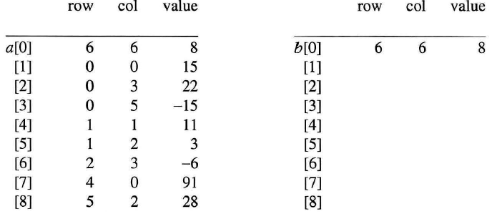

Program 2.9. Fast transpose of a sparse matrix – 연습
Notes:
Errata : p. 79, lines -9 and -8. rowTerms should be 2 1 2 2 0 1 and startingPos should be 1 3 4 6 8 8 as shown in Figure 2.5(b).
[0] [1] [2] [3] [4] [5]
rowTerms= 2 1 2 2 0 1
startingPos= 1 3 4 6 8 8

Slide 2

Program 2.9. Fast transpose of a sparse matrix – 애니메이션
0 0 15
0 4 91
1 1 11
2 1 3
2 5 28
3 0 22
3 2 -6
5 0 -15
2
3
4
5
6
7
8
9

